Slide 1
Ranking model and comparison model results

Slide 2
Ranking model

Slide 3
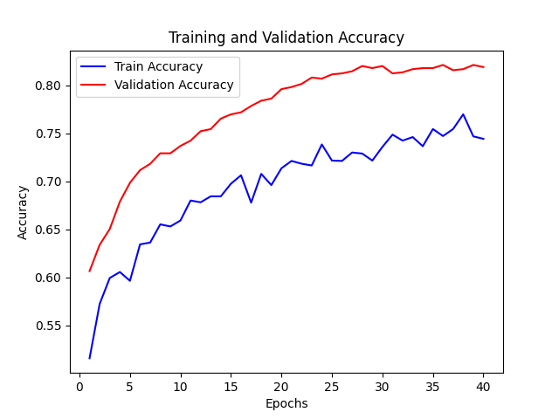
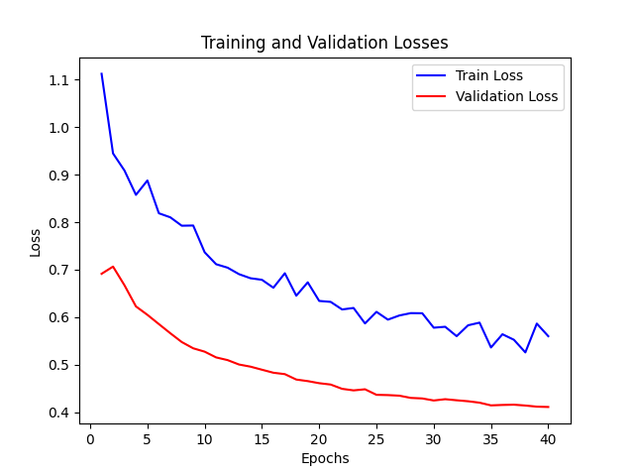
Ranking model 40 epochs with only initial data

Slide 4
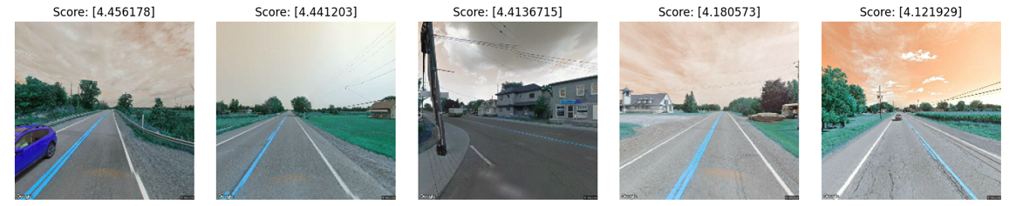
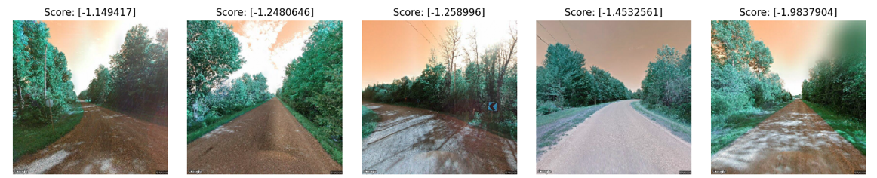
Ranking model 40 epochs with only initial data
Least connected to nature :
Most connected to nature :

Slide 5
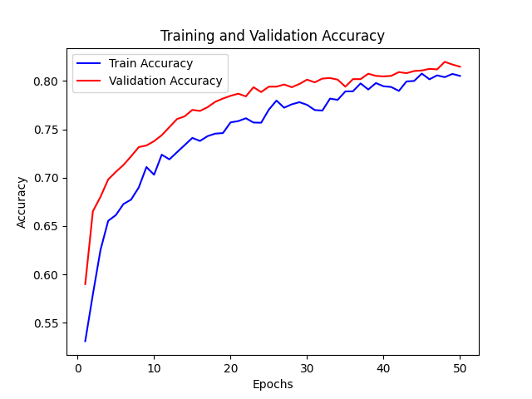
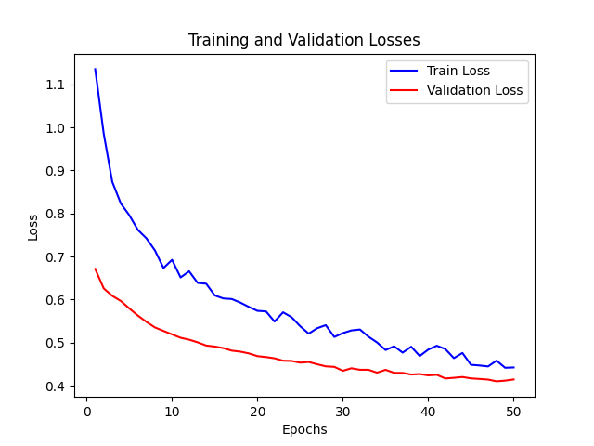
Ranking model with data augmentation trained for 50 epochs

Slide 6
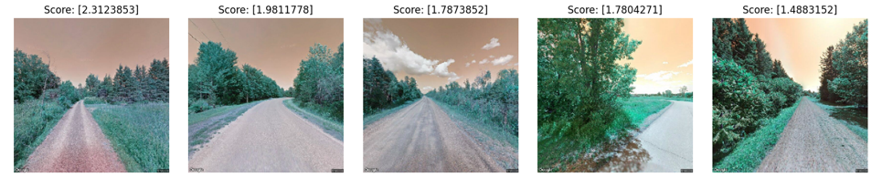
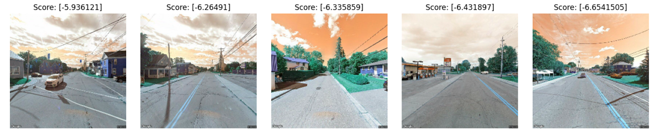
Ranking model with data augmentation trained for 50 epochs
Most connected to nature :
Least connected to nature :

Slide 7
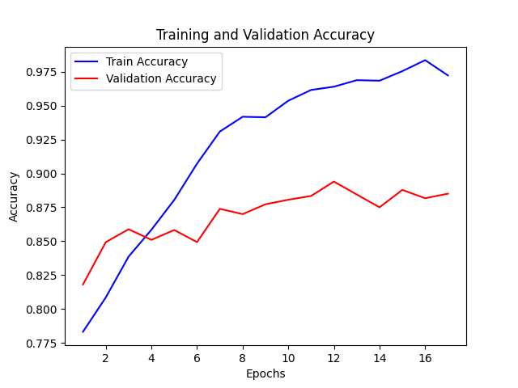
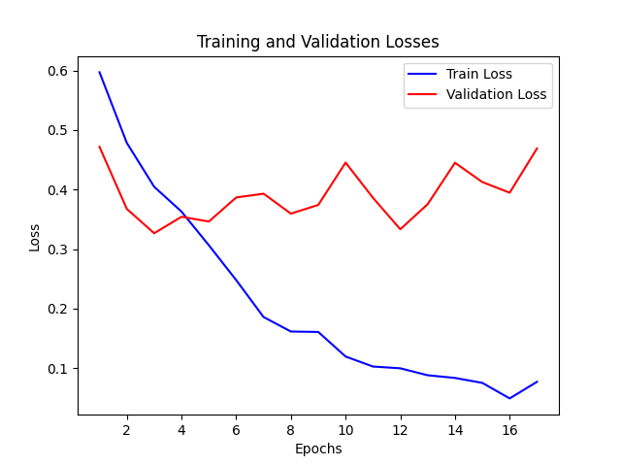
Ranking model with data augmentation fine tuned with random search

Slide 8
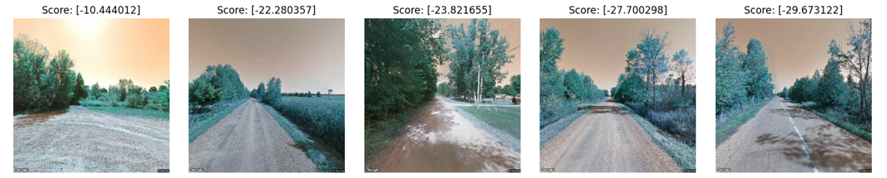
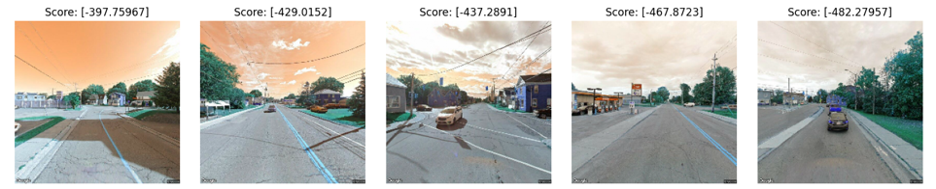
Ranking model with data augmentation fine tuned with random search for 50E
Most connected to nature :
Most connected to nature :
Least connected to nature :

Slide 9
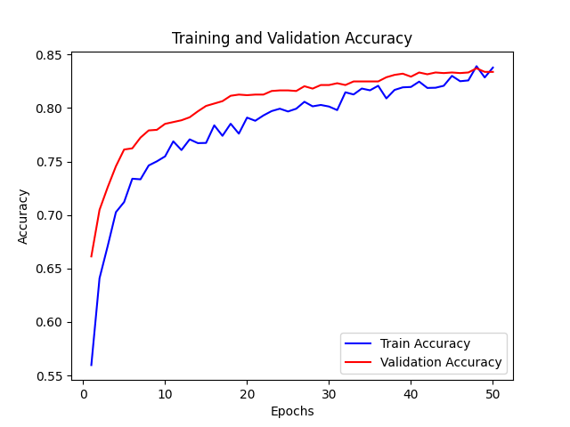
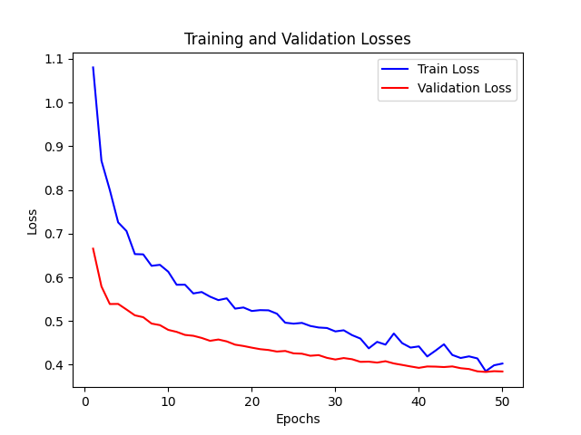
Handpicked ranking model from the tuning process

Slide 10
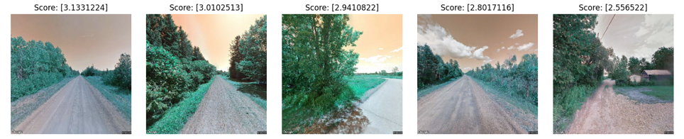
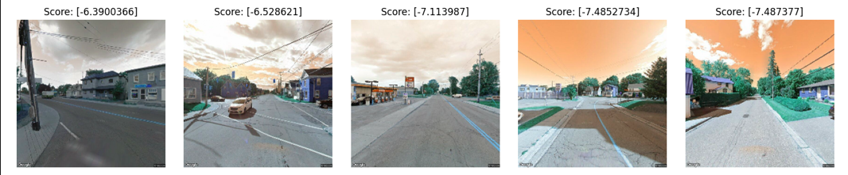
Handpicked ranking model from the tuning process

Slide 11
Comparison model

Slide 12
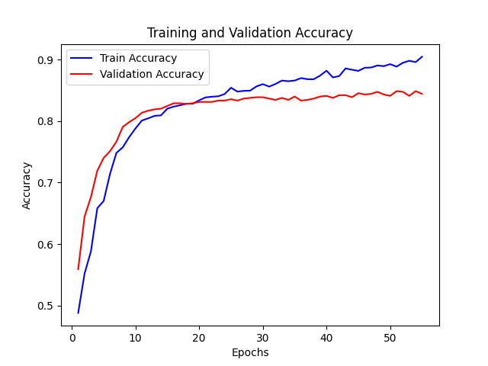
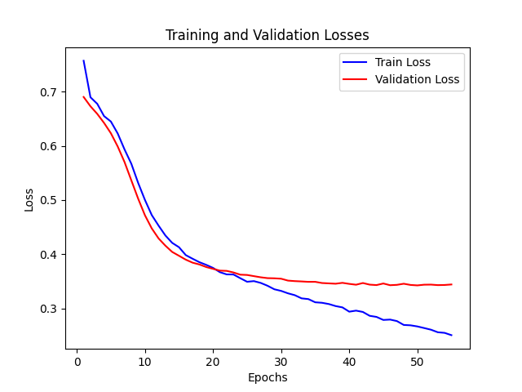
Comparison model trained for 60 epoch with initial data (fine tuned by hand)

Slide 13
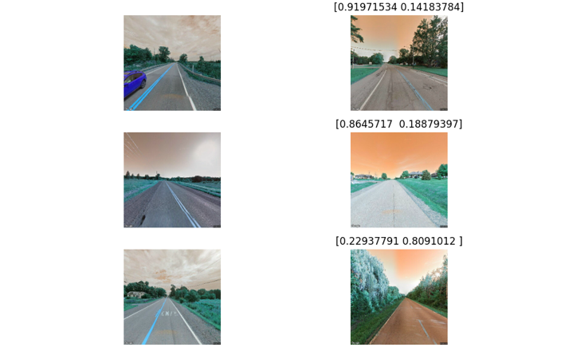
Comparison model trained for 60 epoch with initial data (fine tuned by hand)

Slide 14
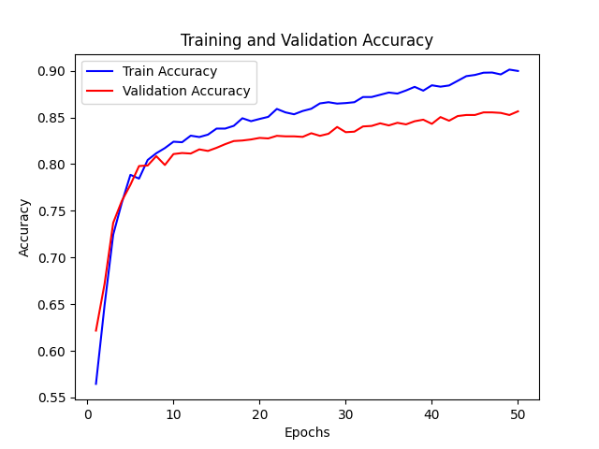
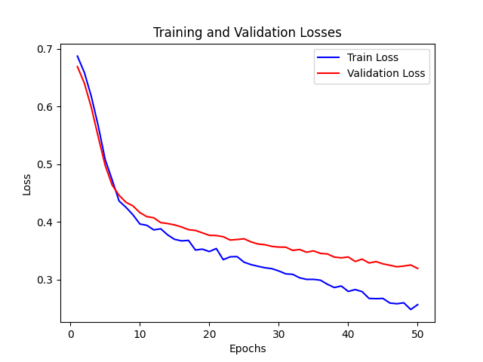
Comparison model trained for 50 epochs with data augmentation

Slide 15
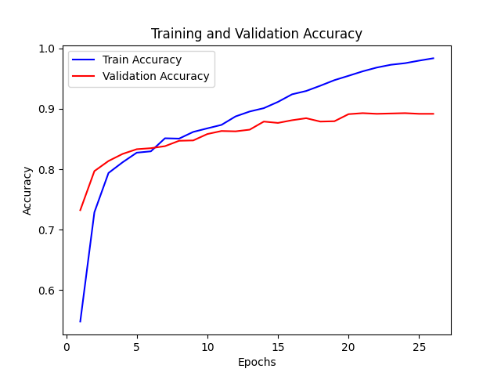
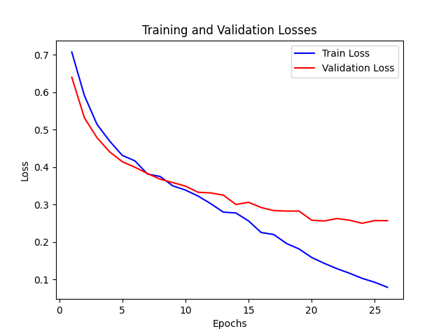
Comparison model tuned with data augmentation

Slide 16
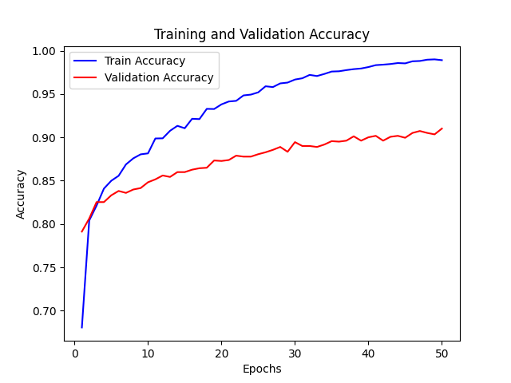
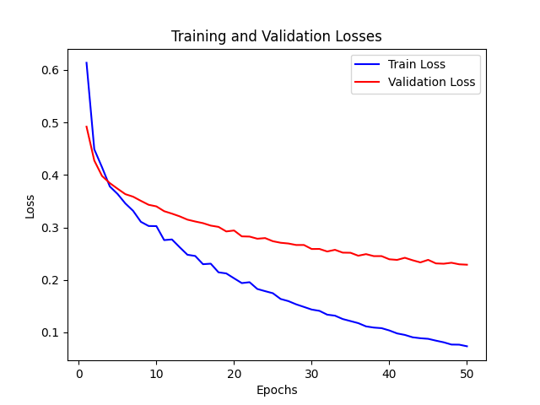
Comparison model handpicked from the tuned models

Slide 17
Mapillary data

Slide 18
How to acquire the data ?
Creating a grid around Ottawa
Getting the coordinates of each centroids of each tiles that constitutes the grid
Create a correct bounding box to get all the data inside of that tile without overlapping (no duplicate data)
Query the Mapillary API to get the image ids and coordonates inside of these bounding boxes
Run another query to complete missing data because API endpoint doesn’t work sometimes
In QGIS run the nearest hub request on the streetview coordinates folder and the centroid coordinates that will give us the ID of the closest image for each images inside
Make a query to download all the images with the resulting Ids (This can contain duplicates because an image can be the closest for multiple points of the streetview data)

Slide 19
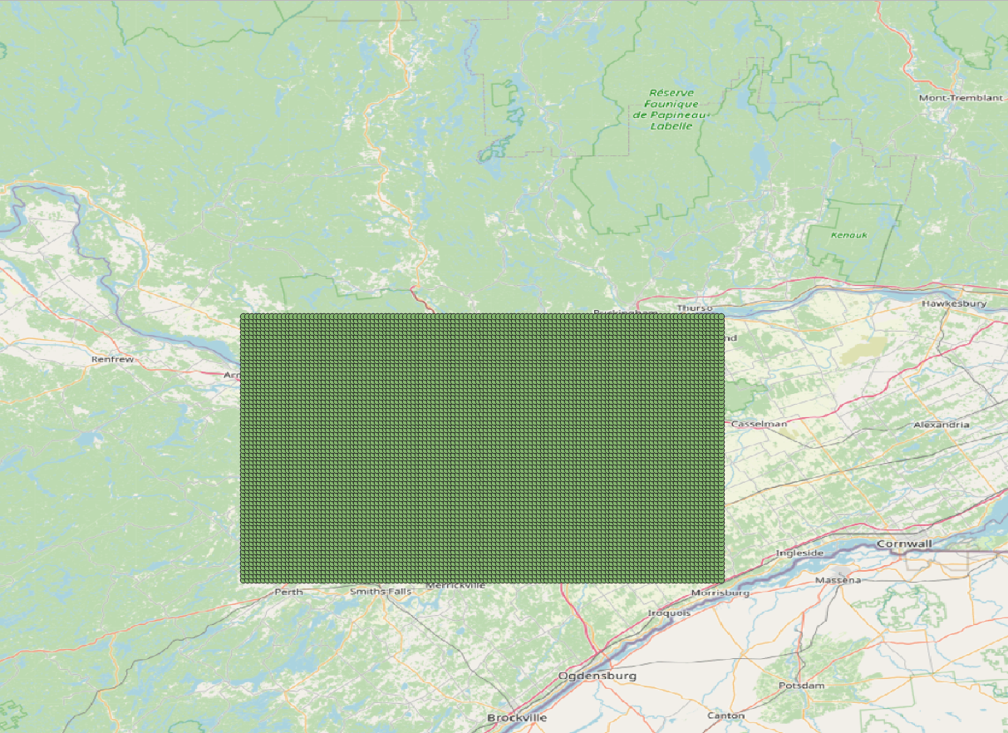
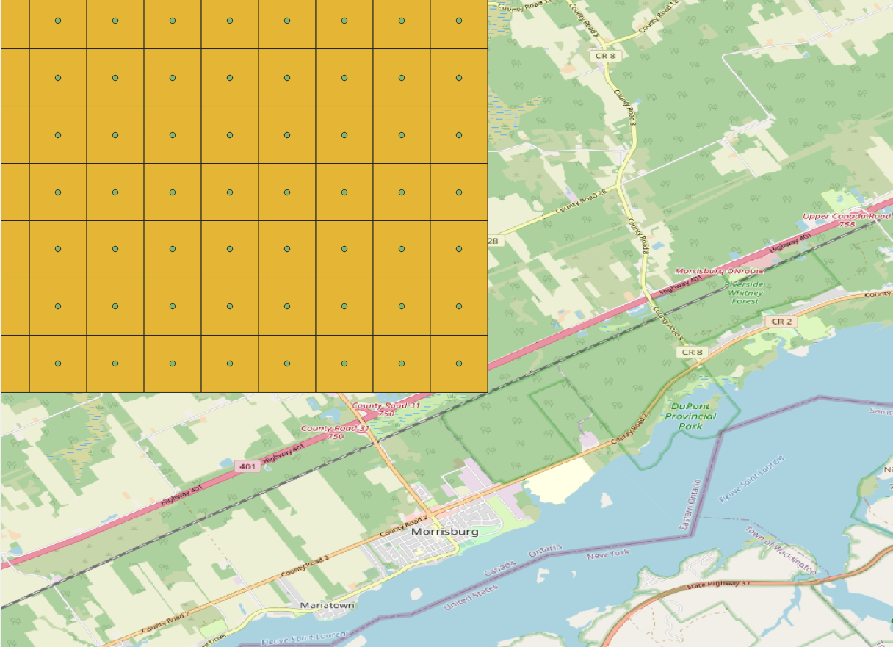
Viewing the grid and the centroids

Slide 20
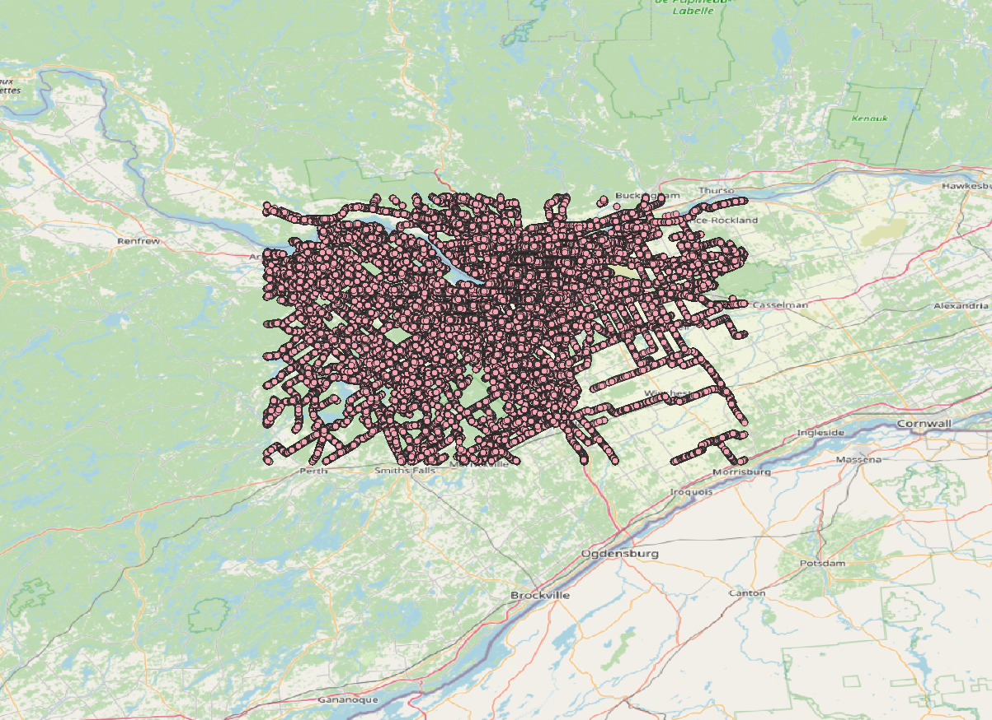
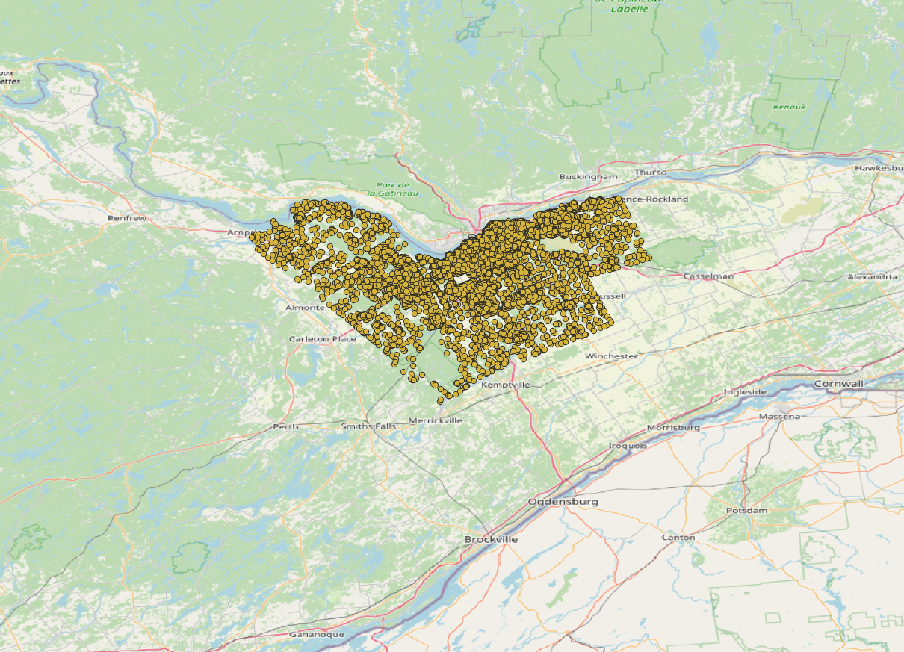
Viewing the streetview data and the data from mapillary (coordinates and id only)
Mapillary data viewed inside QGIS :
Streetview data viewed inside QGIS :

Slide 21
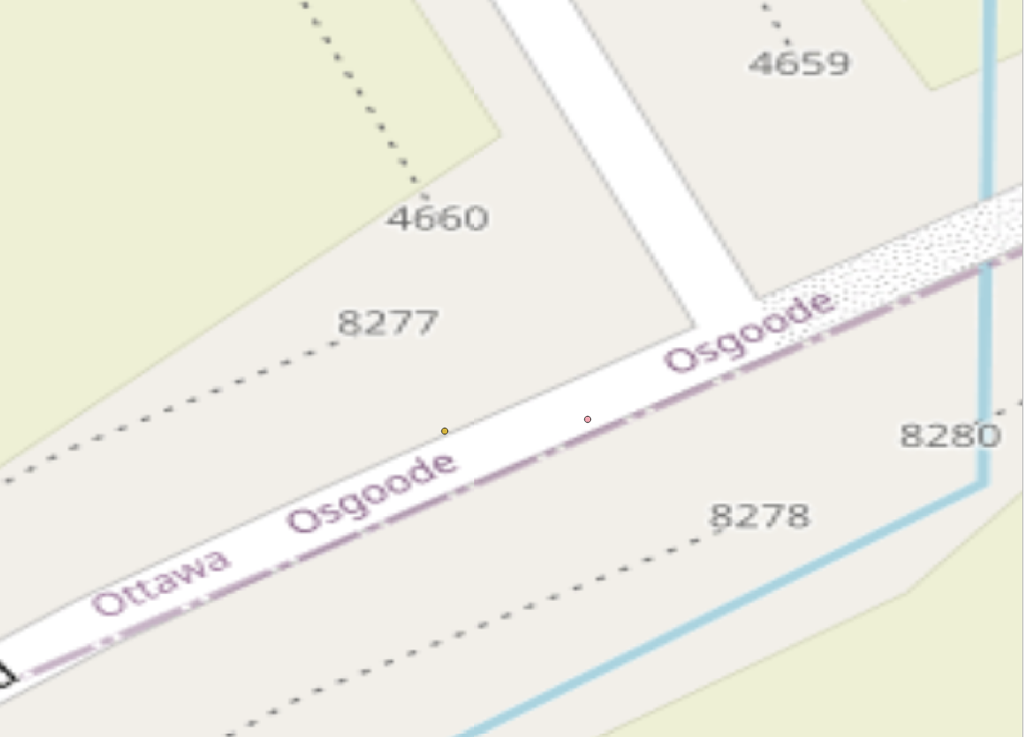
Finding the nearest mapillary point from a streetview point
Point from streetview
Point from Mapillary

Slide 22
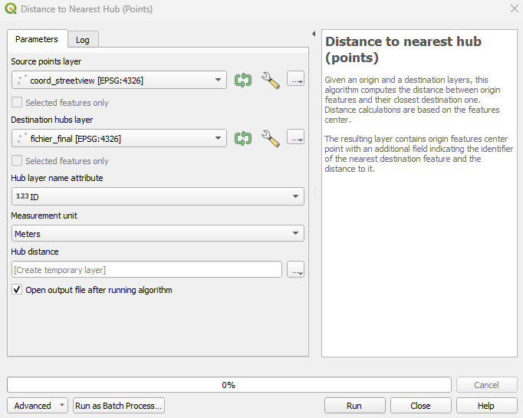
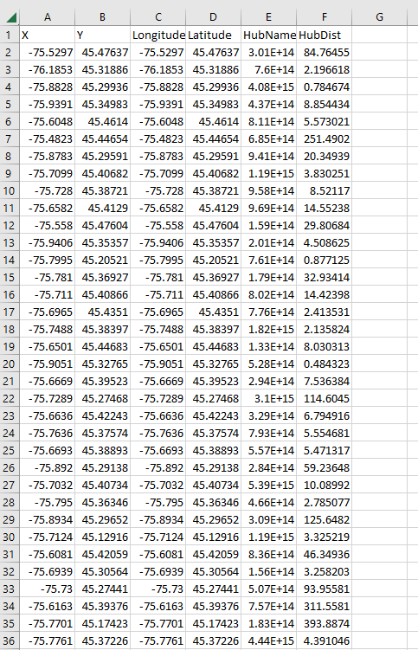
Finding the nearest mapillary point from a streetview point
After converting the resulting GeoPackage into a CSV we get the following file

Slide 23
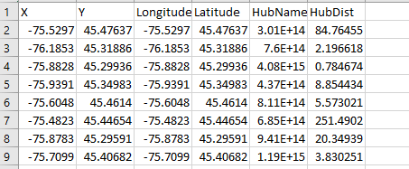
Finding the nearest mapillary point from a streetview point
X, Y : Coordinate of the streetview point
Longitude Latitude : Coordinate of the Mapillary point
HubName : ID of the corresponding Mapillary image
HubDist : Distance in meters from the Streetview point to the Mapillary point

